Slide 1
Building pragmatic mobile applications

Slide 2


Slide 3

Hello!
I am Yogiraj (Yogi Aradhye)
I am here because I want to share things I learned.
I am a technical lead at Headspring. I build mobile, web, and distributed systems. I blog at http://aradhye.com. My twitter handle is @yaradhye

Slide 4
~2.8 million apps in Google Play
~2.2 million apps in Apple store

Slide 5
Mobile technology choice
Responsive Web apps
Hybrid apps
Nativish apps
Sub eco system app
Compile to native apps
Native apps
https://dev.to/kayis/the-mobile-app-spectrum

Slide 6

All the research is pointing towards the jump

Slide 7

Very tough problems
Source: cnn.com

Slide 8
In school, you're taught a lesson and then given a test. In life, you're given a test that teaches you a lesson.
-Tom Bodett, Actor, Author, etc

Slide 9
Project Background and context
Build an App
Mix of features and wish lists
Everything is important
Some challenges

Slide 10
Agenda
1
2
3
4
5
6
7
8
Business case guideline
User Interface
Architecture and Design
System Overview
Programming the App
DevOps for the App
External Interfaces
Rejection

Slide 11
Business case guidelines
1
The why

Slide 12
Answer critical questions
Why do we need an app instead of a responsive web application?
Is the core of our business going to be impacted?
Can we commit to this one hundred percent?

Slide 13
Priorities
Define Identity
Feature rich?
Small & faster iterations?
Measure everything and know your user

Slide 14
User interface
2
Let’s take a look

Slide 15
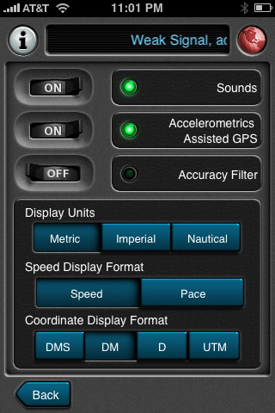
User interface
Has everything that the business wanted!
What’s wrong?
https://theresaneil.wordpress.com/2011/08/22/bad-mobile-apps-ui-design-gone-wrong/

Slide 16
Lesson
Less is more!

Slide 17
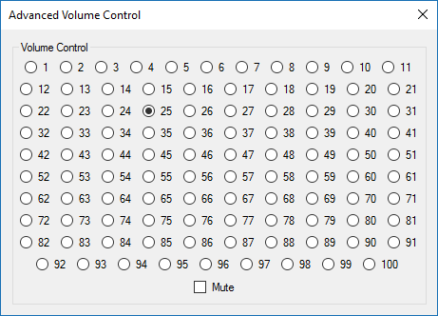
Volume control
https://uxdesign.cc/the-worst-volume-control-ui-in-the-world-60713dc86950

Slide 18
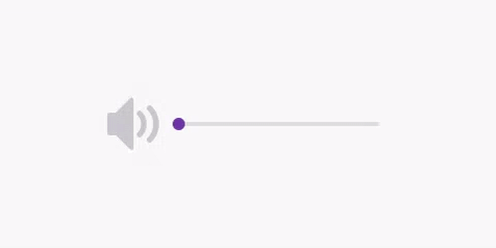
Volume control
https://uxdesign.cc/the-worst-volume-control-ui-in-the-world-60713dc86950

Slide 19
Lesson
Fancy doesn’t mean useful

Slide 20
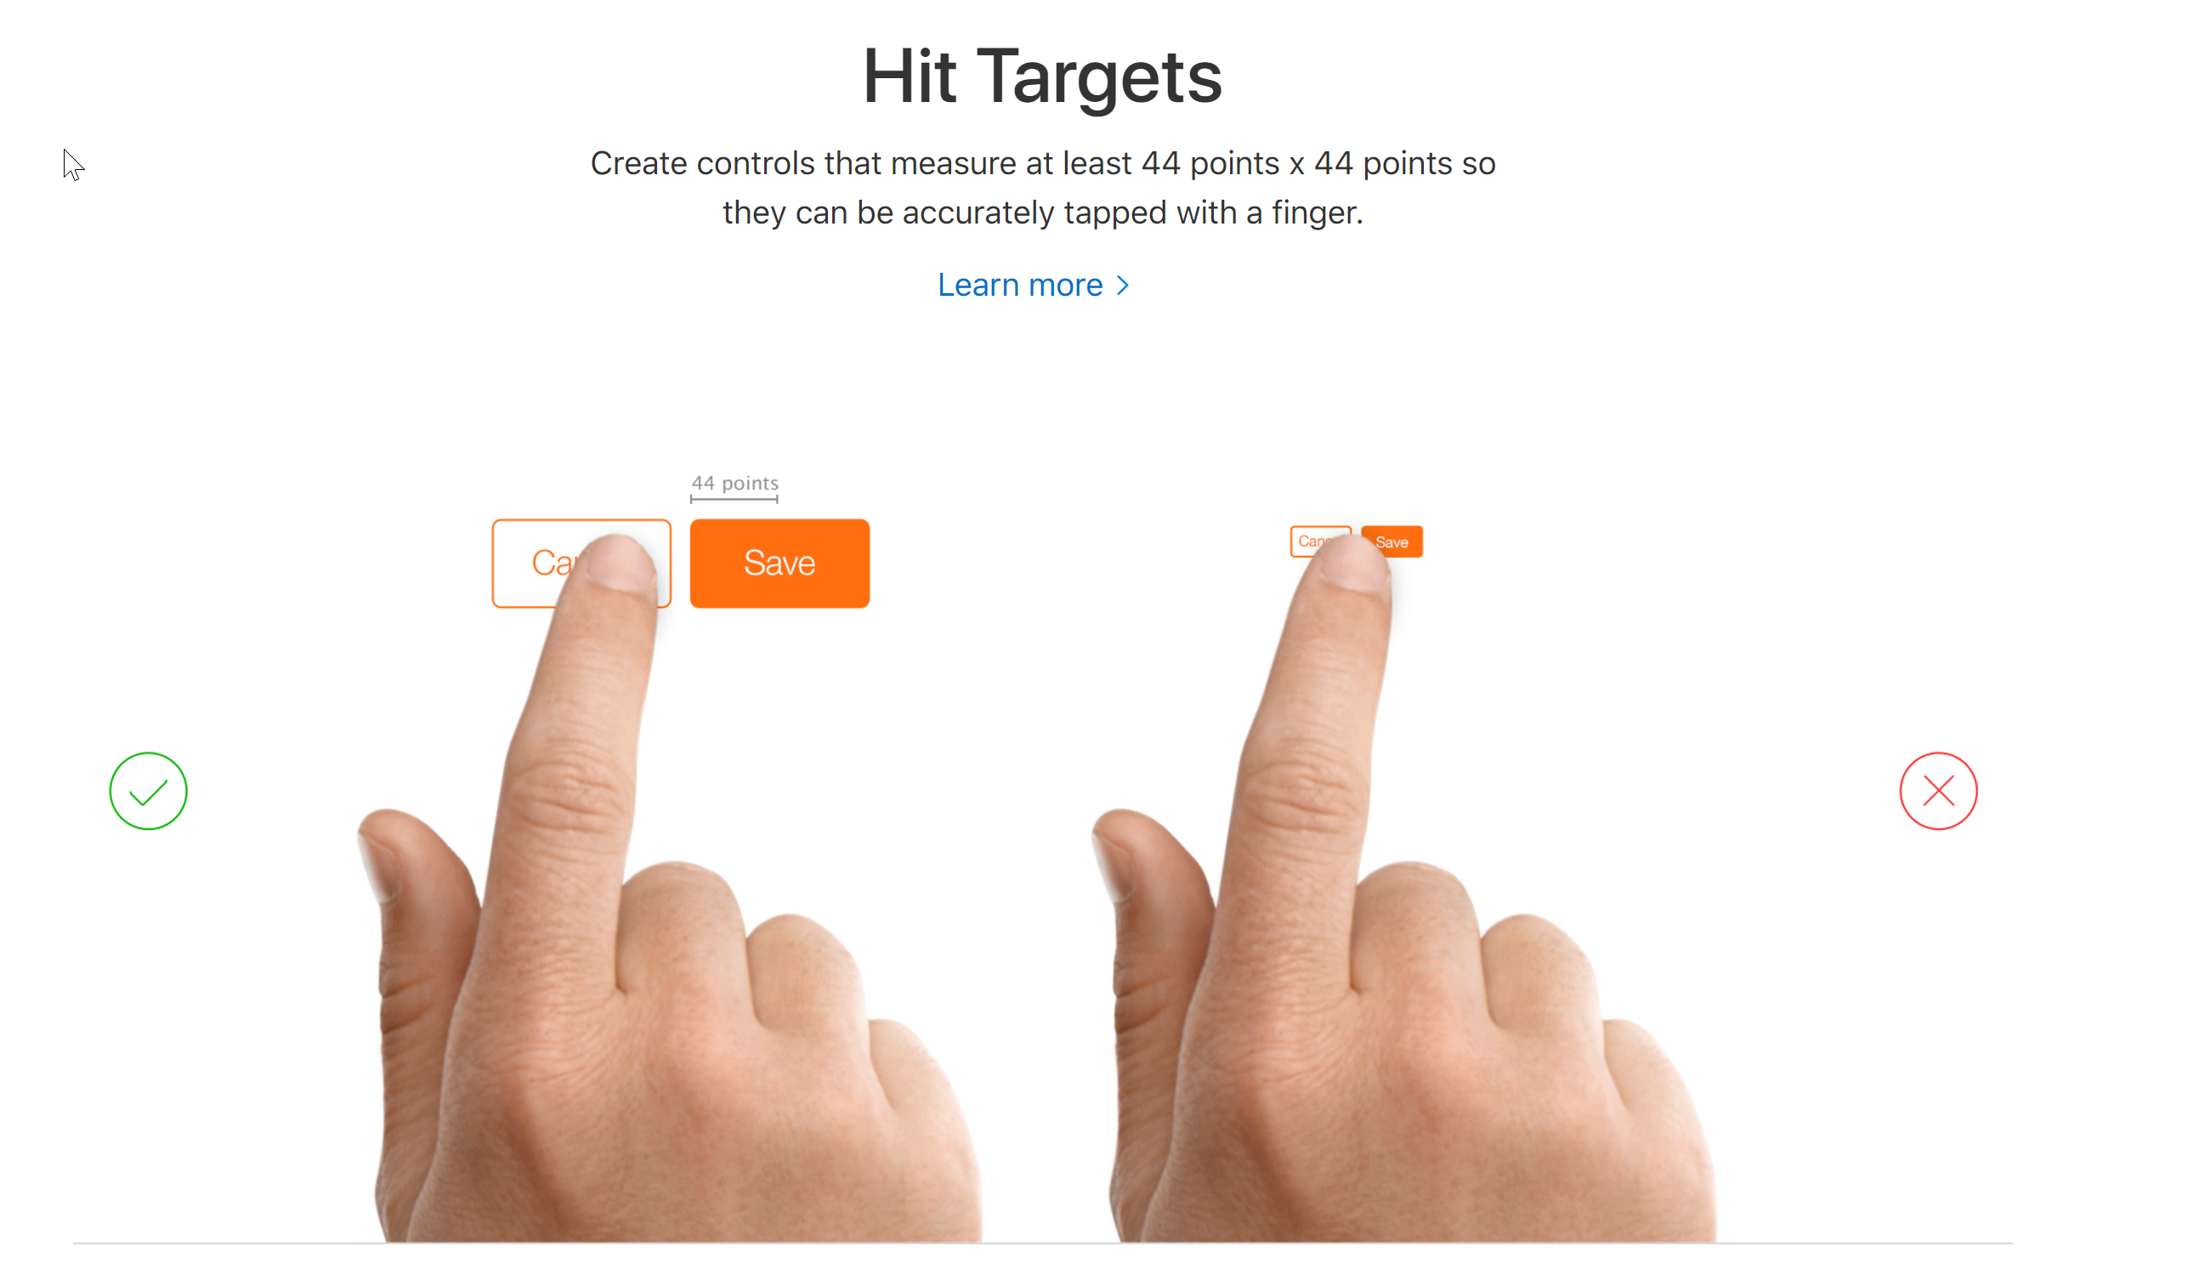
Setting up the users for success
https://developer.apple.com/design/tips/

Slide 21
Lesson
Keep human limitations in mind

Slide 22
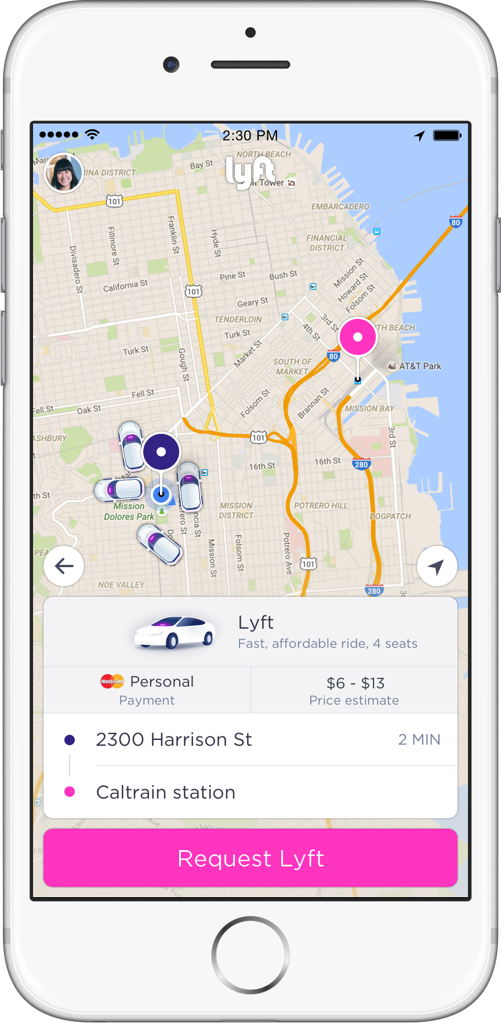
Simple and awesome
Lyft
Does only a few things but does them exceptionally well!
https://lyft.com

Slide 23
Lesson
Learn from the successful apps
Pro tip: Don’t copy

Slide 24
Lesson
Follow the app store guidelines

Slide 25
Readings
https://webflow.com/blog/10-essential-ui-design-tips
Apple Tips https://developer.apple.com/design/tips/
Android Tips https://developer.android.com/training/best-ui.html
https://thenextweb.com/apps/2015/08/28/10-usability-considerations-mobile-app/#.tnw_s8ZhHpYT

Slide 26
Architecture and Design
3
Let’s take a look

Slide 27
Communication
Types (Bluetooth, WiFi, VPN, Cellular)
Occasionally connected, low bandwidth scenarios
Degrade gracefully instead of breaking

Slide 28
Xamarin Connectivity Plugin
Types of connection
Events on changes in connection
Checks Bandwidth
https://www.nuget.org/packages/Xam.Plugin.Connectivity

Slide 29
Lesson
App has to remain functional in case of the network loss

Slide 30
Power management
Don’t make the app chatty
Have separate battery profiles
Color choices on Android

Slide 31
Lesson
Battery usages issues has real consequences

Slide 32
Local storage
Purge the data that is not used
Realm.io for non sensitive info
Keychain for sensitive

Slide 33
Lesson
Understand the data sensitivity and accessibility
Ream.io for non sensitivity and frequently accessed

Slide 34
Readings
Give this a read old blog but still good https://msdn.microsoft.com/en-us/library/ee658108.aspx

Slide 35
System Overview
4
The what

Slide 36
Primary System Components
Mobile App
iOS and Android
Xamarin Forms
ReactiveUI
Realm.io
Azure Notification Hub
API and Web App
ASPNETCORE on .NET 4.6.1
EFCore
Angular 2 and TypeScript
IdentityServer
SQL 2016
File processors
NserviceBus
Npoco

Slide 37
Secondary System Components
Infrastructure
TFS - CI and CD for web and other backend systems
Jenkins – mobile app
Interface services
Multiple Windows services to interface with other existing applications

Slide 38


High level architecture
Cloud
API
API DB

Slide 39
Programming the App
5
Let’s take a look

Slide 40
What’s the Xamarin appeal?
Common code sharing
C#
The team is fantastic!
Xamarin Forms and Xaml
IDE choice

Slide 41
Lesson
Mind shift for mobile apps is required even with Xamarin

Slide 42
Shared libraries
Architecture crisis - which class is being used for which project?
Littered with If Platform X then do everywhere

Slide 43
Portable Class Libraries
Improvement over shared project but introduces profiles

Slide 44
Netstandard
Uniform set of BCL APIs for all .NET platforms.
Libraries that are usable across .NET runtimes.
Reduces/eliminates conditional compilation of shared code.

Slide 45
Lesson
Migrate to Netstandard

Slide 46
Reactive programming
Based on observer pattern
Working with asynchronous data streams
Streams are immutable
Reactive gives provides functional way to deal with these streams

Slide 47
Reactive programming – searching cities
Time
User input stream
A
U
S
T
Throttle(TimeSpan.FromSeconds(3))
Data flow
U
User input stream
A
S
T
WhenAny(x => x.SearchQuery, x=>x.Value.Trim() && x.Value.Length>3)
T
S
User input stream
U
A

Slide 48
Reactive UI based on RX
Highly declarative code!
The filters can be bound to the UI elements
Concentrate on logic than plumbing
Great community support

Slide 49
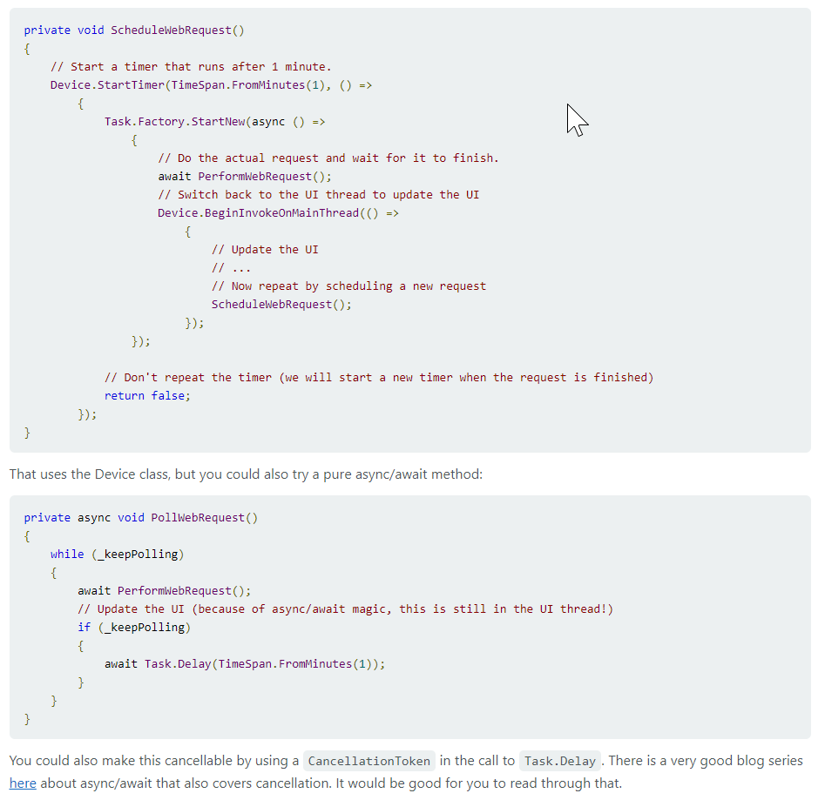
Non reactive timer code
https://forums.xamarin.com/discussion/30936/device-starttimer-async

Slide 50
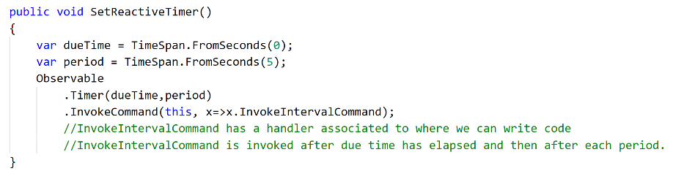
Reactive timer code

Slide 51
Lesson
Reactive programming simplifies a lot of things because its asynchronous and functional

Slide 52
Readings
The introduction to Reactive Programming : https://gist.github.com/staltz/868e7e9bc2a7b8c1f754
ReactiveUI : https://reactiveui.net/
Timer: https://msdn.microsoft.com/en-us/library/system.reactive.linq.observable.timer(v=vs.103).aspx
http://reactivex.io/documentation/operators/timer.html

Slide 53
Service Location with Splat
Why service location?
Splat is more than service location
Unit testing friendly

Slide 54
Lesson
Use service location for performance

Slide 55
Readings
https://stackoverflow.com/questions/26898381/reactiveui-view-viewmodel-injection-and-di-in-general

Slide 56
Singleton .Net HttpClient?
Cross cutting concerns such as cookies, credentials etc.
Each request with a new HttpClient requires re-establishing a new TCP/IP connection.
Closing network ports on Windows takes long time. You could hit server port exhaustion.

Slide 57
Lesson
Use singleton for .Net HttpClient for performance at the client and the server side

Slide 58
Readings
https://stackoverflow.com/questions/22560971/what-is-the-overhead-of-creating-a-new-httpclient-per-call-in-a-webapi-client/35045301#35045301
https://docs.microsoft.com/en-us/aspnet/web-api/overview/advanced/calling-a-web-api-from-a-net-client

Slide 59
Charting lessons
There are a lot of basic ones. Telerik is good enough for now. Microcharts look promising.
https://github.com/aloisdeniel/Microcharts

Slide 60
Logging and monitoring
Device logging ☹
Hockey App crash reporting
Crashlytics

Slide 61
Lesson
Introduce crashlytics as soon as possible

Slide 62
Testing
Regular Nunit or Xunit testing mainly for view models
Xamarin UI Tests ☹

Slide 63
Testing Lesson
Automated testing can’t replace manual testing yet

Slide 64
DevOps for the App
6
Let’s take a look

Slide 65
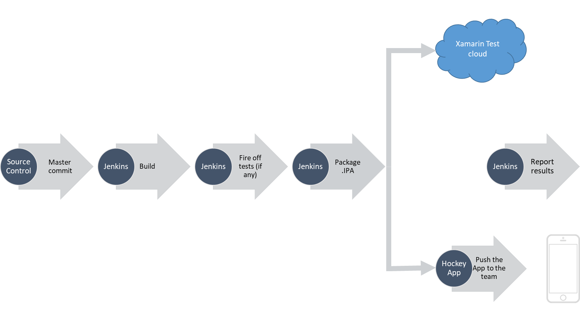
CI and CD

Slide 66
DevOps
Apple and Certificates ☹
Use homebrew to install Jenkins
.jenkins is a hidden folder and that has all the workspaces
Mobile.Azure.Com
Check https://github.com/fastlane/Fastlane

Slide 67
Lesson
Set this up as part of Sprint 0
Apple certificates on the build machine

Slide 68
External interfaces
7
Let’s take a look

Slide 69
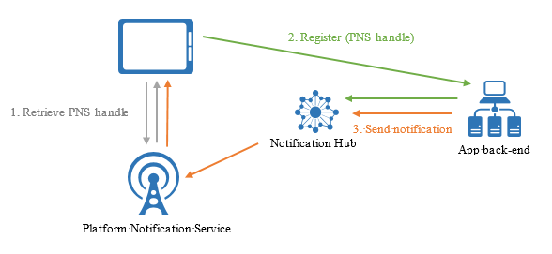
Azure Notifications hub
https://docs.microsoft.com/en-us/azure/notification-hubs/notification-hubs-push-notification-overview

Slide 70
Lesson
Use Azure notifications hub instead of PNS

Slide 71
Rejection
8
Who likes this?

Slide 72
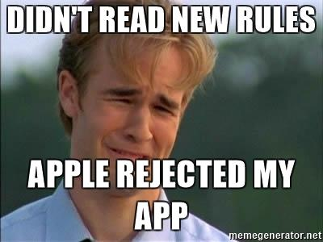
Rejection

Slide 73
Rejection
Need to provide a public API for Apple
That has to be IPv6 compatible

Slide 74
Lesson
Put the API addresses behind a domain name

Slide 75
That was quite a journey
The how

Slide 76
Key take aways
Less is more
Setup monitoring and measure everything!
Follow store guidelines
Go Reactive!
Don’t be discouraged by the problems and keep chipping away logically

Slide 77

Thanks!
Any questions ?
You can find me at
@yaradhye
Presentation link:
https://github.com/YogirajA/Presentations

Slide 78
SlidesCarnival icons are editable shapes.
This means that you can:
Resize them without losing quality.
Change line color, width and style.
Isn’t that nice? :)
Examples:

Slide 79
😉
Now you can use any emoji as an icon!
And of course it resizes without losing quality and you can change the color.
How? Follow Google instructions https://twitter.com/googledocs/status/730087240156643328
✋👆👉👍👤👦👧👨👩👪💃🏃💑❤😂😉😋😒😭👶😸🐟🍒🍔💣📌📖🔨🎃🎈🎨🏈🏰🌏🔌🔑 and many more...

